Slide 1
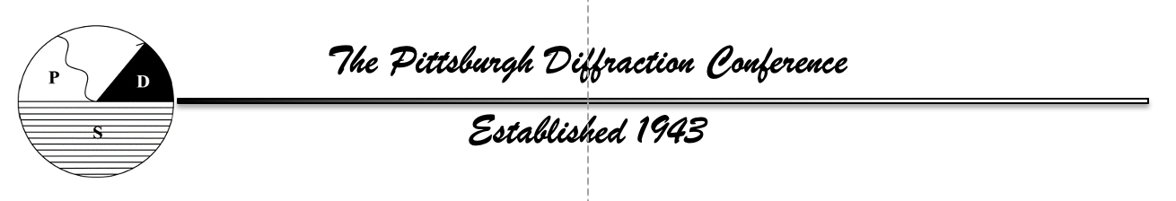
Recollections of Pittsburgh Diffraction Conferences Past
1977 – 2023 Part 2
John P. Rose
Department of Biochemistry and Molecular Biology
University of Georgia, Athens, GA
80th Annual Pittsburgh Diffraction Conference
October 14 – 17, 2023
Pittsburgh, PA
Photos provided by B.C. Wang

Slide 2
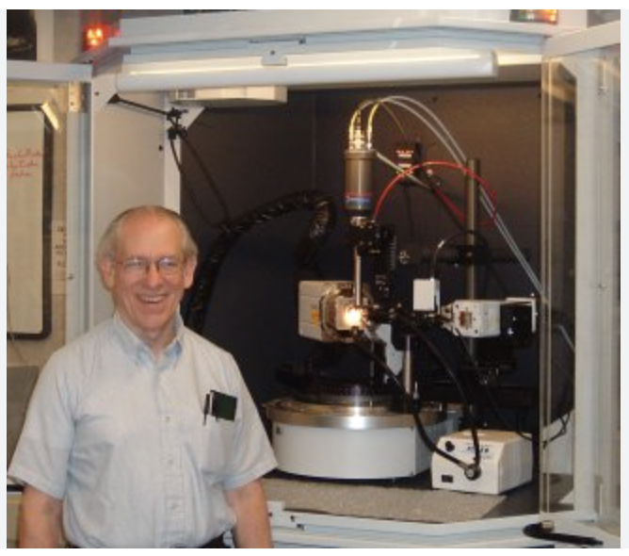
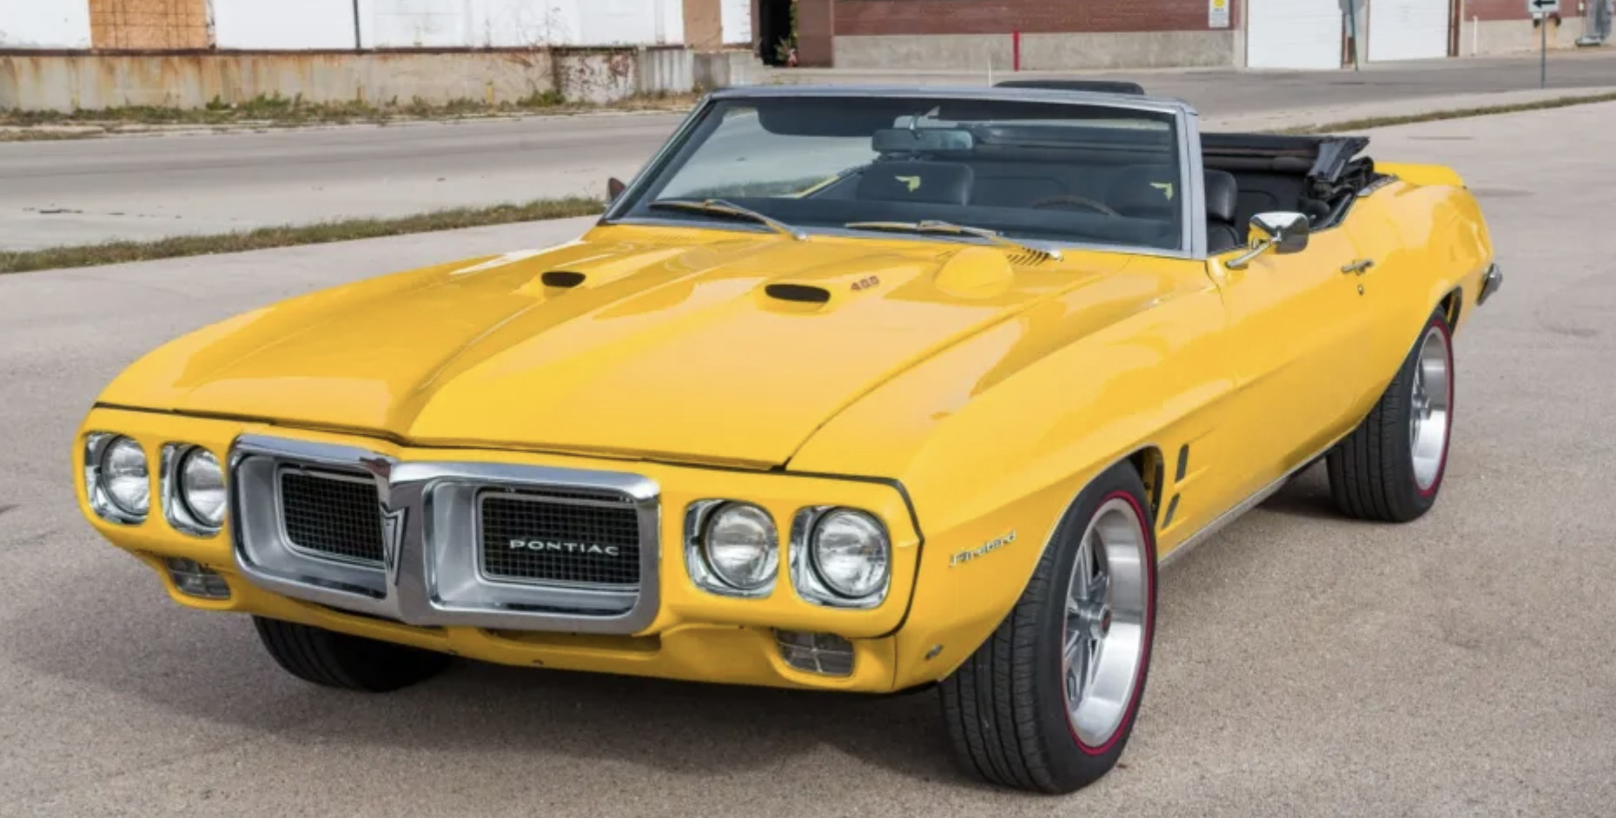
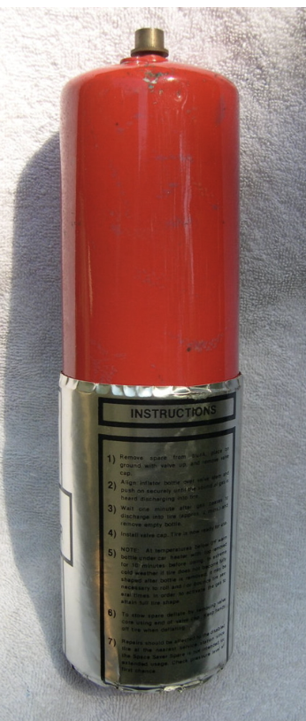
1978 - My first Pittsburgh Diffraction Conference
Bill Furey and I were graduate students at Rutgers working for Roger Lalancette doing small molecule crystallography
Bill had just graduated and was working for B.C. Wang at the VA Medical Center in Pittsburgh
Bill contacted me and said that I should attend the PDC in October an meet B.C. Wang since he was looking for a postdoc
Roger and I then hatched a plan to attend the PDC at low cost
We would leave for Pittsburgh around 3 am attend the PDC & meet with B.C. Wang an then head back
The PDC was amazing since I had been to only a couple of local meetings
I do remember Keith Hodgson & George DeTitta’s receiving the Sidhu Award and the flat tire we got on our way home, and being stranded on the PA turnpike for several hours before help arrived
Roger Lalancette
Roger’s 69 Sunbird convertible
Roger’s defective CO₂ tire
inflator

Slide 3
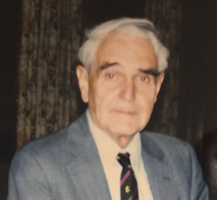
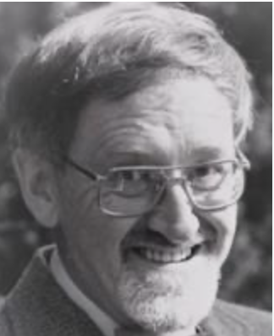
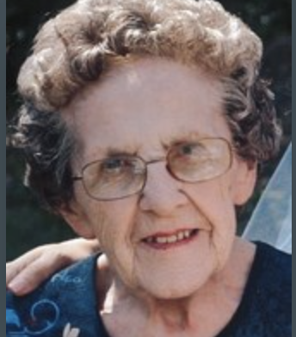
The PDC & the Department of Crystallography
The Department of Crystallography was founded 1969 by J.A. Jeffery.
Other members of the Department during my time at Pitt were Bryan Craven, R. Shino, Dave Stout, B.C. Wang, John Ruble, Joan Klinger (chief organizer) and a goodly number of graduate students and postdocs
Other scientists would visit for a short time including several Nobel Laurates and leaders in various fields. One long term visitor was Don Koenig, co-author on the 1st Lysozyme paper.
The Pittsburgh Diffraction Conferences were held yearly in Pittsburgh at that time and the Department played a vital role
It was all hands on deck professors, postdocs and grad students were all expected to help with Conference logistics
George Jeffrey
Bryan Craven
Joan Klinger

Slide 4
PDC Logistics
It was during this time the Conference was held yearly in Pittsburgh
I came to know its background and how each year’s Conference was organized
Date/Time
Location
Publicity
Sessions
Speakers
Housing
Coffee breaks
Banquet
Vendors
November Organizational Meeting
‘A meeting was generally held in early November to discuss the previous meeting which just ended and to start planning for next years meeting
A Date and Time was chosen consistent with the previous PDC dates
People then volunteered for the various jobs (at left) and went about organizing their various activities
The group of organizers would then meet regularly to ensure everything was taken of by Jan 1, so that publicity (date, time, location, session topics, keynote speakers, etc. could sent out
Updates (new speakers and titles) to the initial program would follow

Slide 5
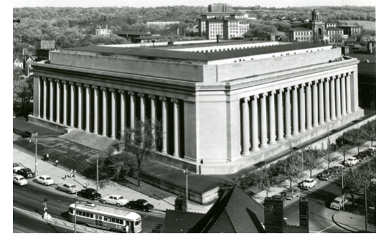
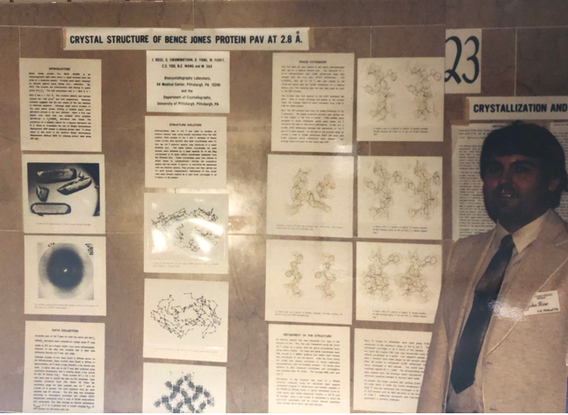
PDC Location
Usually the PDC was held in the Mellon Institute Auditorium since we had CMU members in the organization committee we could get it for free
The Mellon Institute had an art deco
inspired interior designed with polished
marble walls
Posters were then pasted to these walls
eliminating the need for poster boards
(LEFT) My poster hanging on the Mellon Institute walls during the PDC.
The poster describes the first protein structure (Bence Jones Protein Pav) determined by B.C. Wang’s ISIR method.
Work
C.S. Yoo – purification & data collection
W.F. Furey – data processing & initial ED
maps
J.P. Rose – fitted sequence & refinement
B.C. Wang – developed the ISAS tool
M. SAX – over saw the project
Photos provided by B.C. Wang

Slide 6
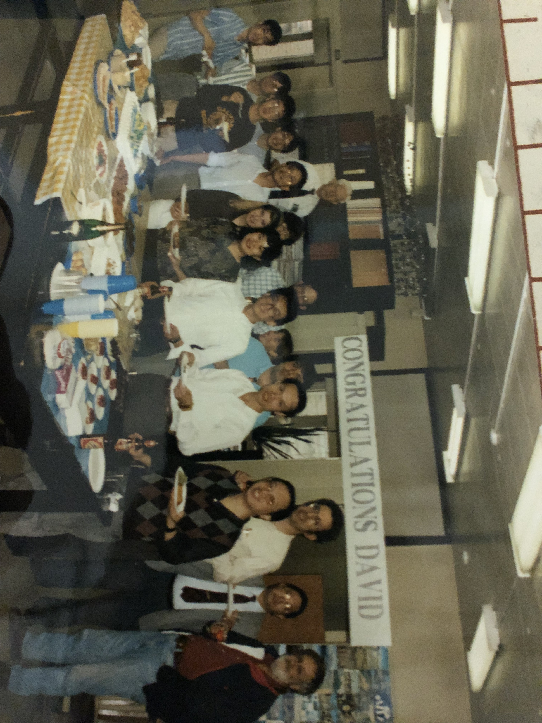
PDC Workers
This photograph honoring the success defense of David’s dissertation also provides a glimpse of the people who made the PDC a success

Slide 7
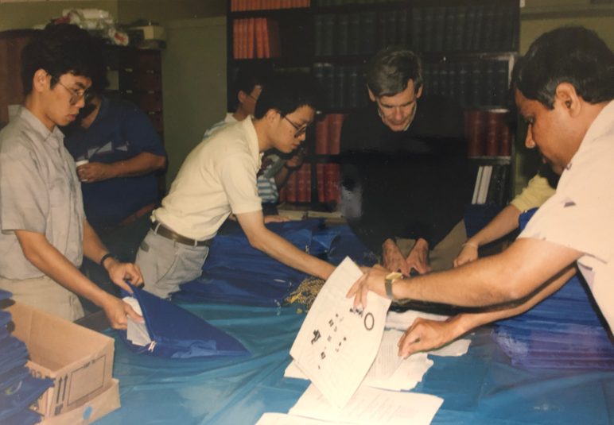
PDC Workers Assemble Program
Graduate students and a postdoc help Don Koenig assemble the PDC program package
Don had many interesting stories about the early days of MX crystallography

Slide 8
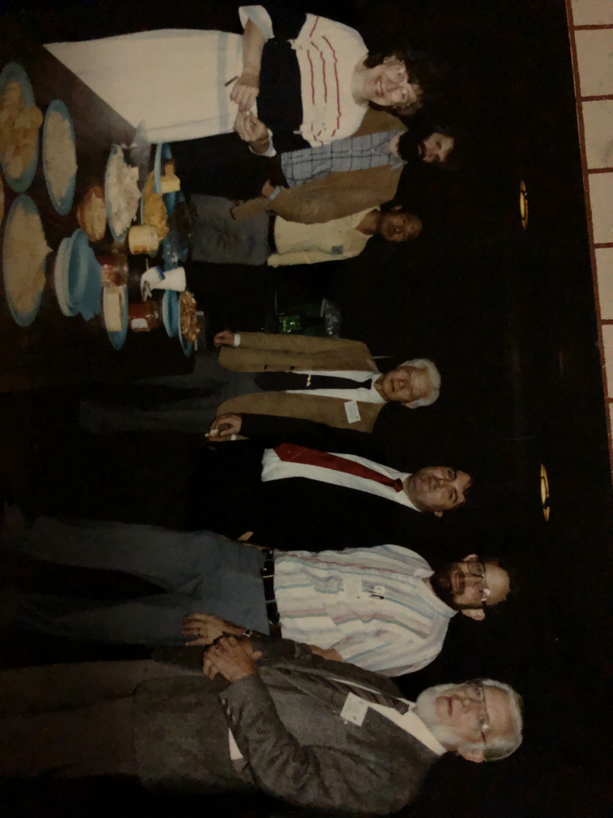
PDC banquets always had good Wine & Cheese
(L-R) Wingert, Furey, Chung, Shiono, Rose, Ruble, Steitz

Slide 9
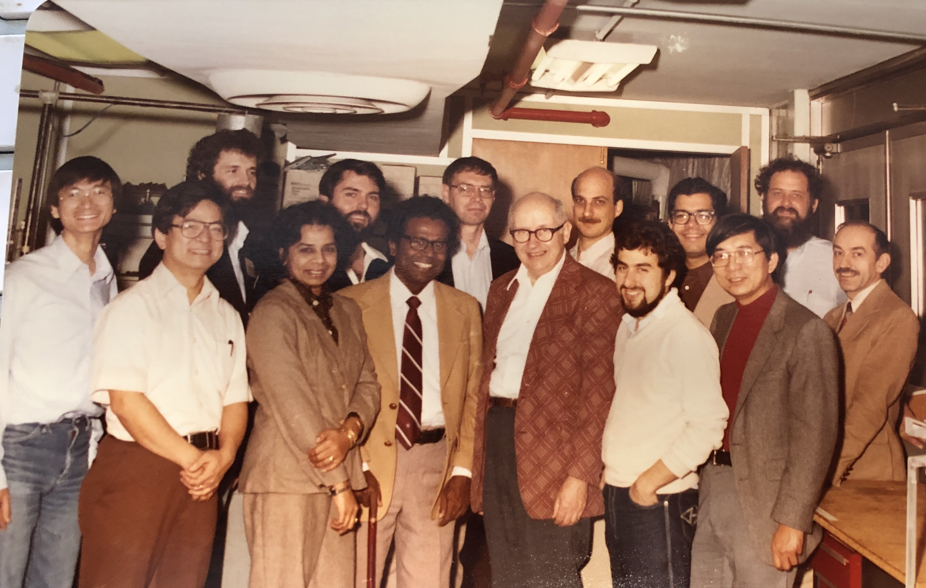
PDC Lab Tours
Dr. & Mrs Muttaiya Sundaralingam and guests

Slide 10
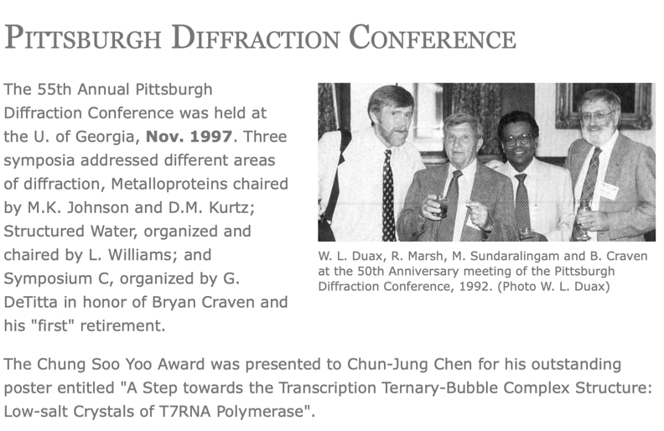
The 55th PDC honoring the work of Bryan Craven
From ACA News Letter

Slide 11
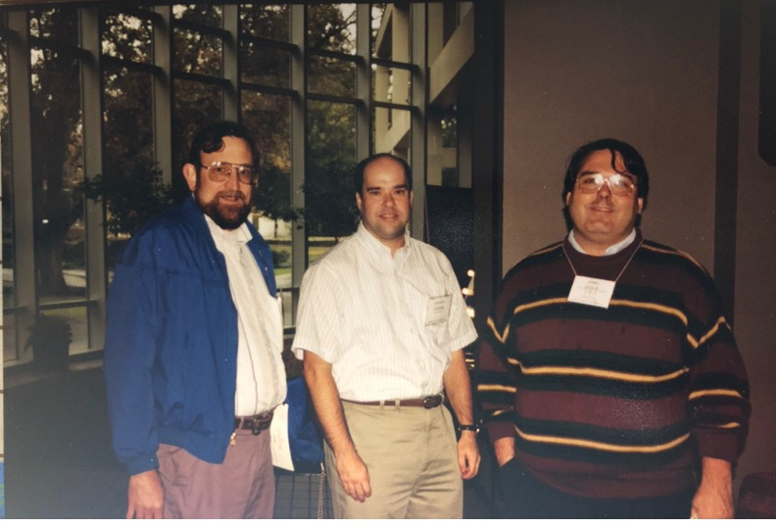
The 55th PDC Steve Geib Saves the Day
John Ruble, Steve Geib and John Rose
We did not know it but Steve was a pilot and filled his plane with Iron City beer for the banquet

Slide 12
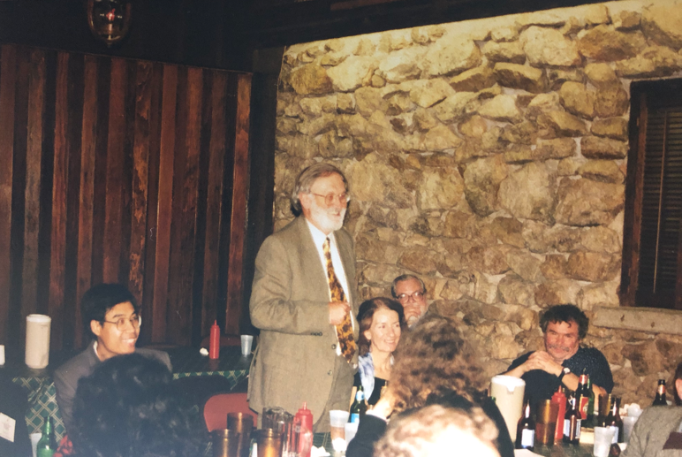
The 55th PDC banquet - Bryan speaks
Bryan making a speech at the banquet while Bob Stewart & George DeTitta watch

Slide 13
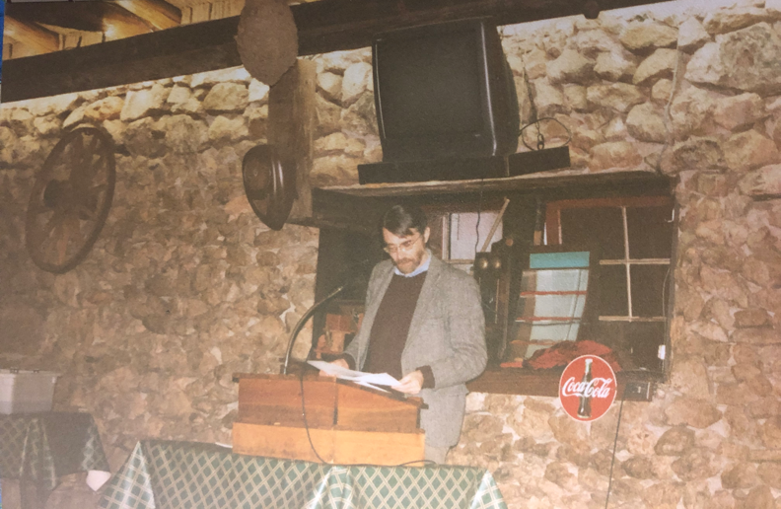
The 55th PDC banquet – A poem
Ode to the Laser Heated Diamond Anvil Cell
B.C. Wang bumped into a poet at Kinkos while he was making some copies
The poet saw the phrase “Laser Heated Diamond Anvil Cell” and was intrigued
B.C. told the poet that if he shows him the poem before the banquet he will get in for free
The rest is history

Slide 14
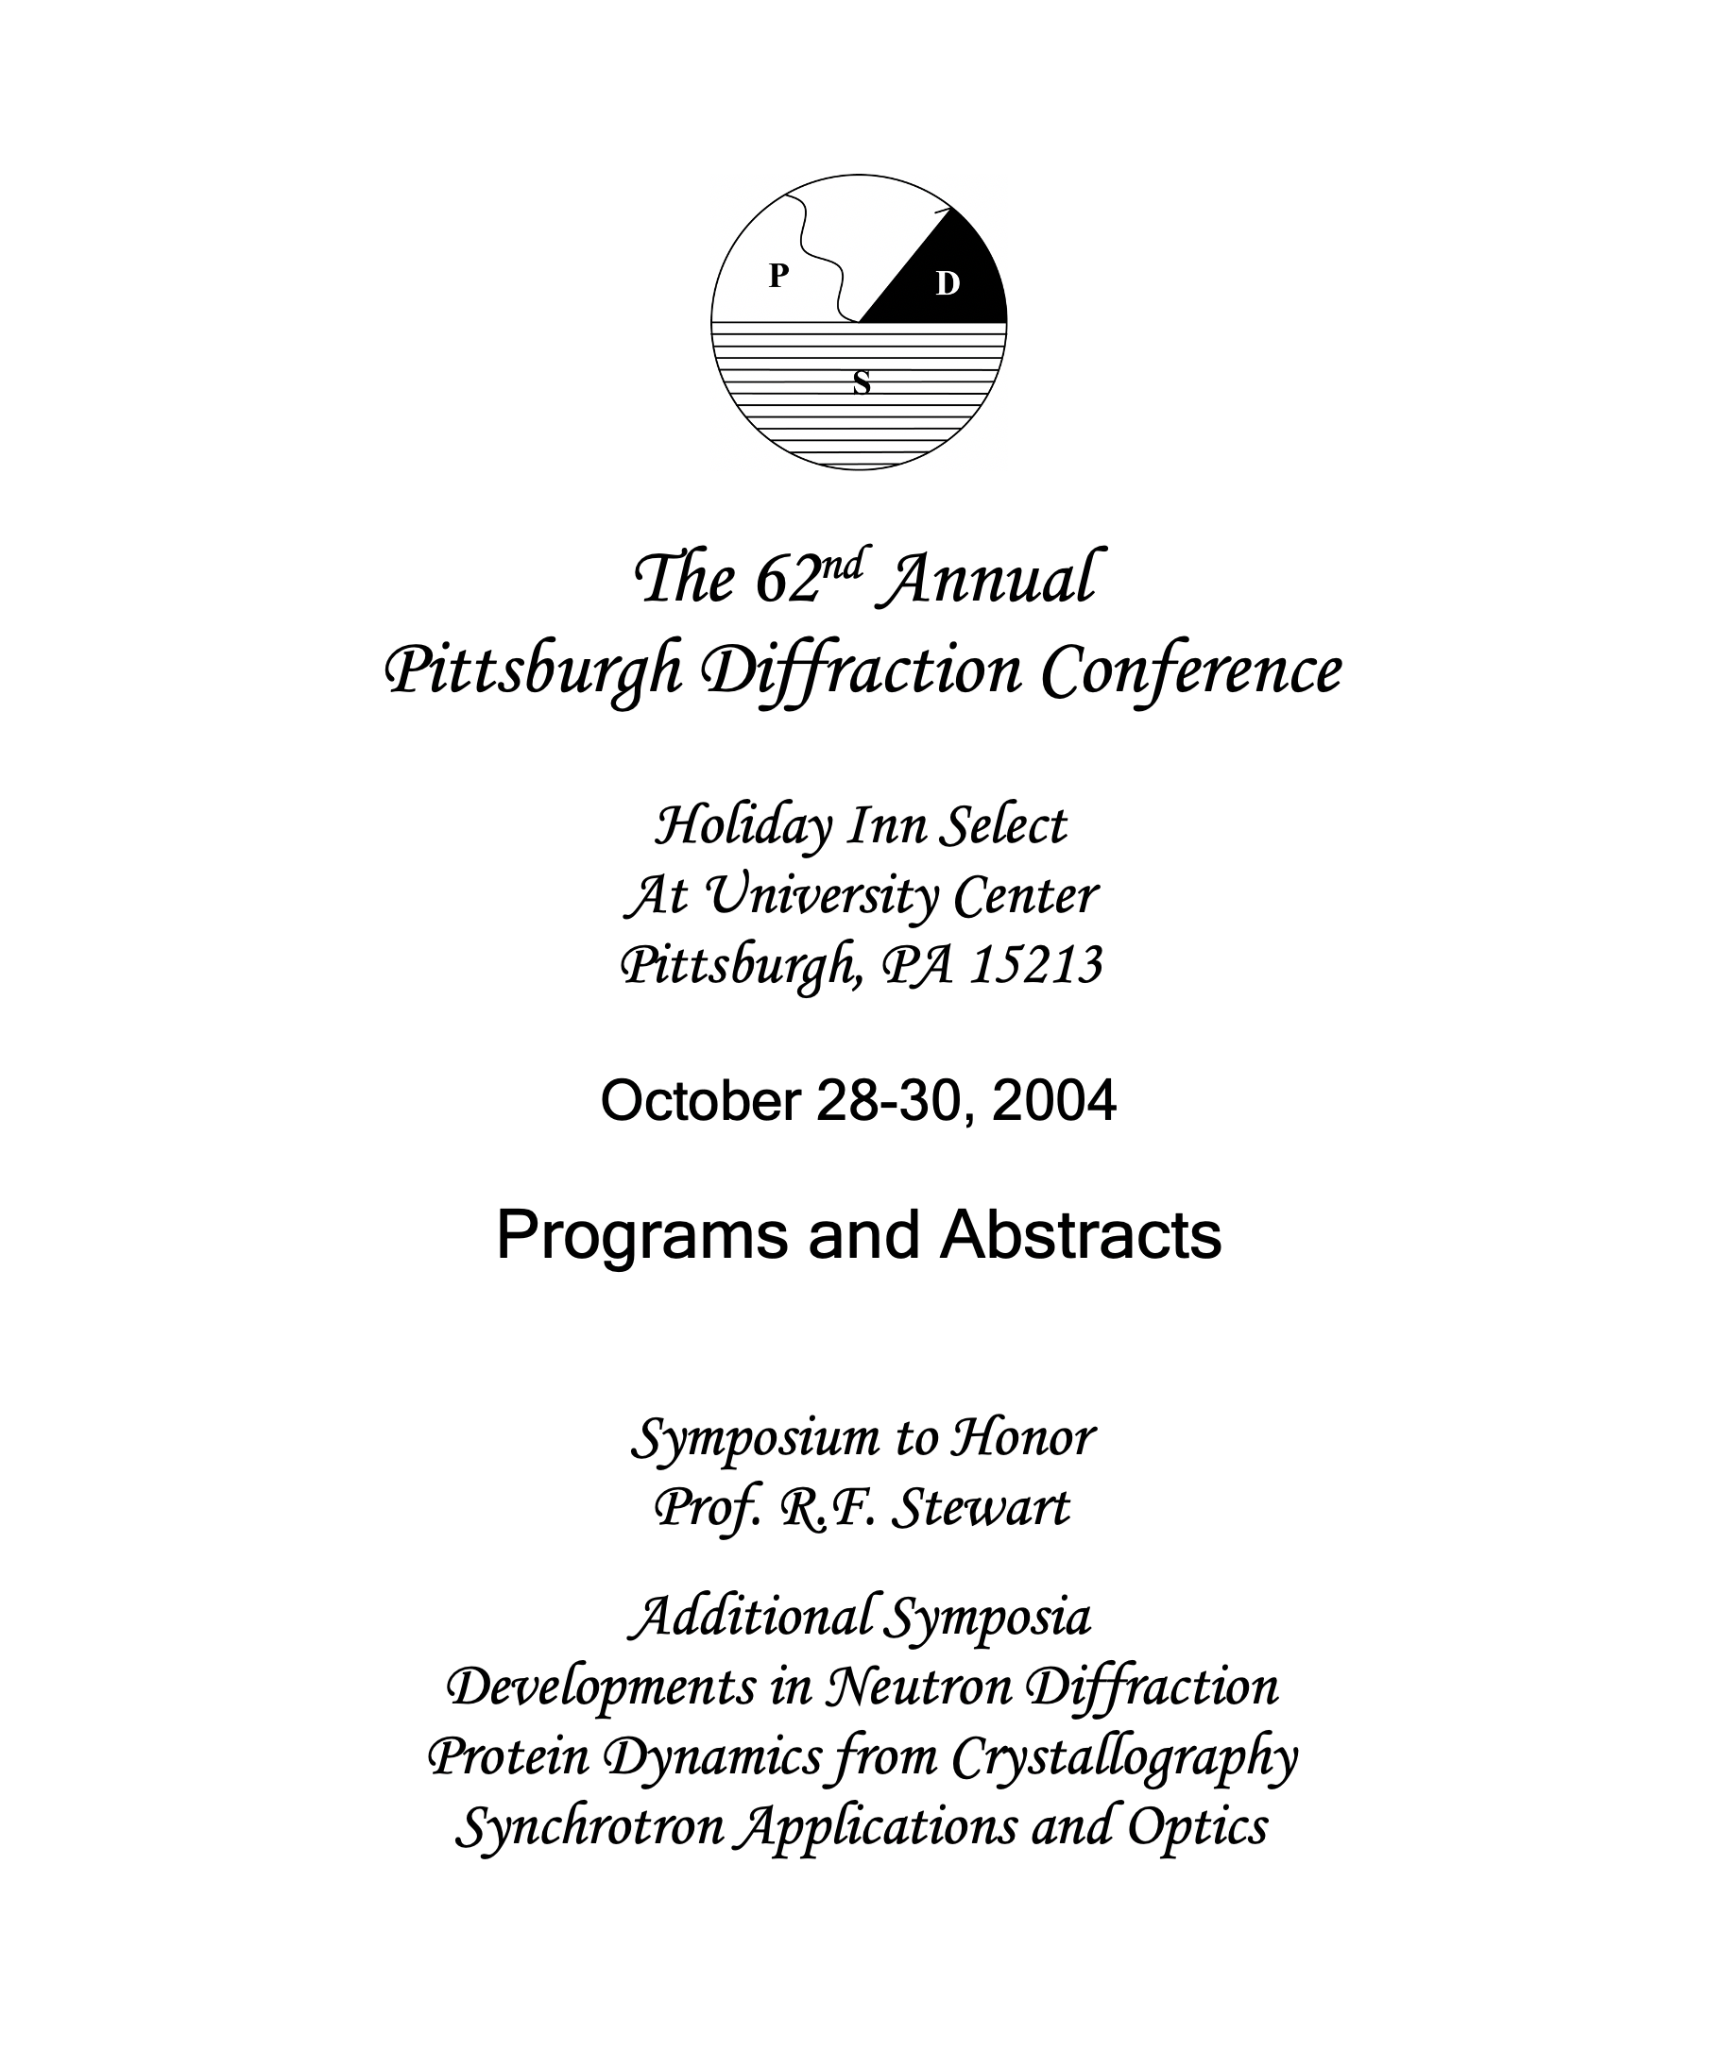
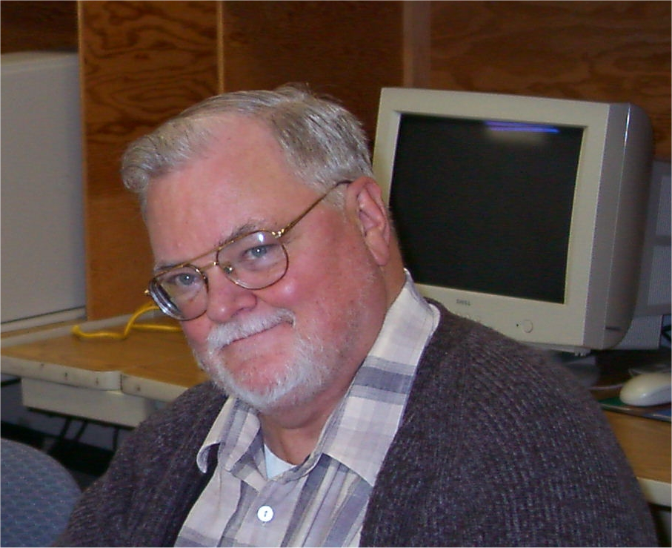
The 62th PDC honoring the life of R.F. Stewart
“On the occasion of the 62nd Pittsburgh Diffraction Conference, colleagues, collaborators and friends from around the world meet to celebrate the scientific career of Robert (Bob) Farrell Stewart.”
He was a great supporter of the PDC

Slide 15
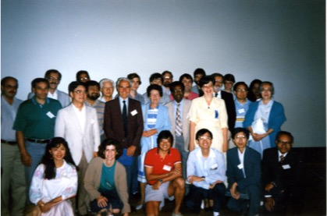
Group Picture at the 65th PDC
G.A. Jeffrey and wife at center

Slide 16
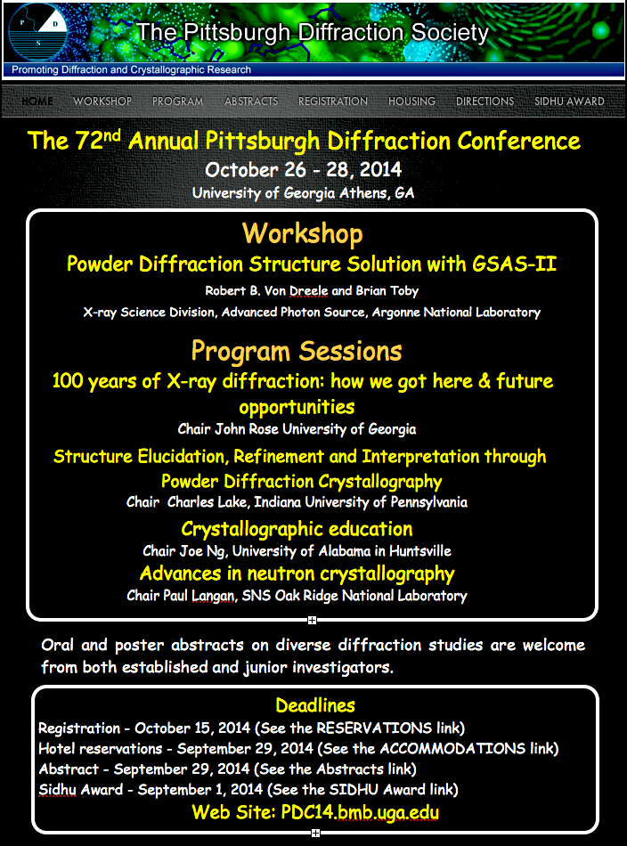
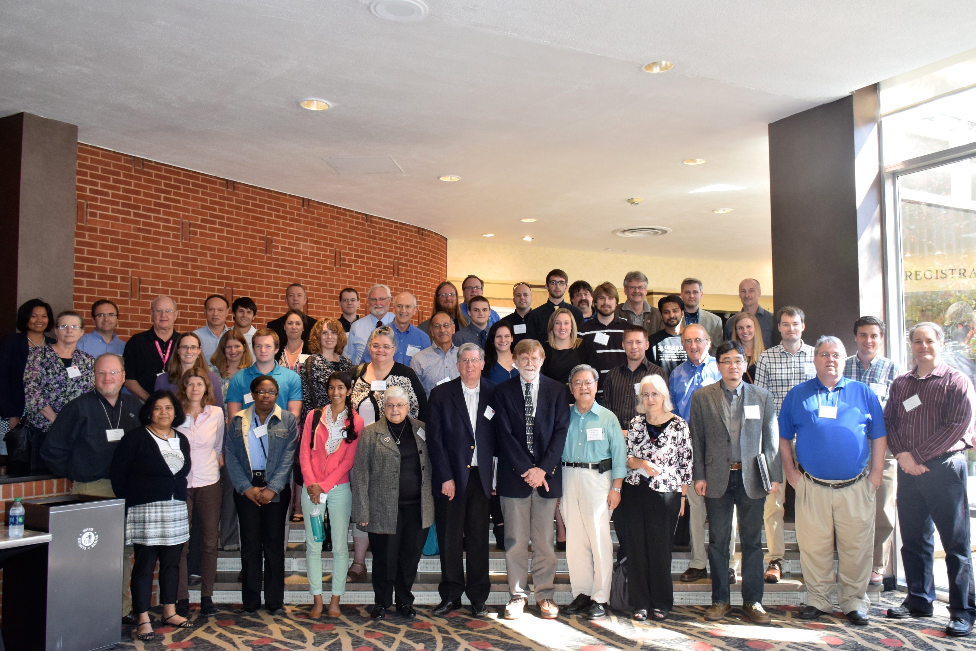
72nd Pittsburgh Diffraction Conference
Athens, GA
Group photograph taken at the Georgia Center for Continuing Education
Brian Matthew’s was the Key Note speaker and provided an entertaining account of the early days of crystallography

Slide 17
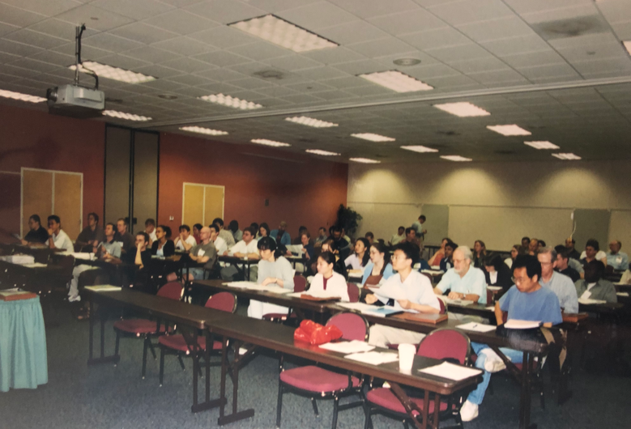
72nd Pittsburgh Diffraction Conference
Athens, GA
Attendees take notes during the GSASII workshop

Slide 18
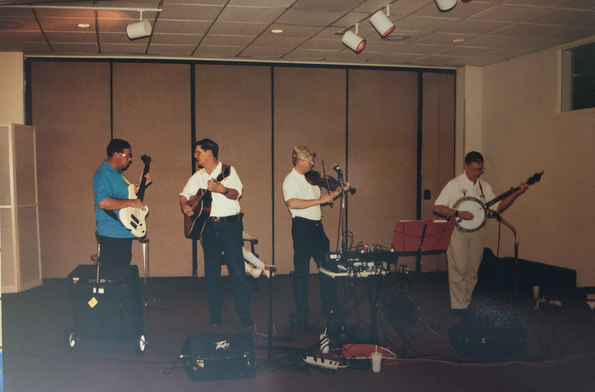
72nd PDC Conference Banquet
Banquet attendees were entertained by a country music quartet

Slide 19
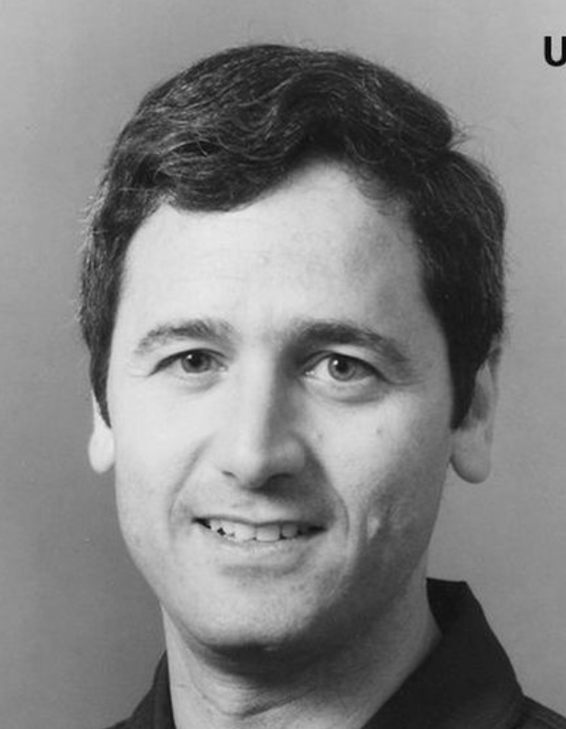
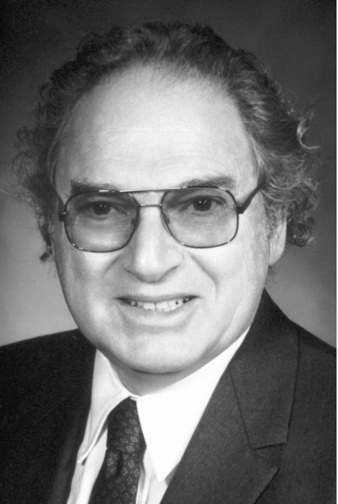
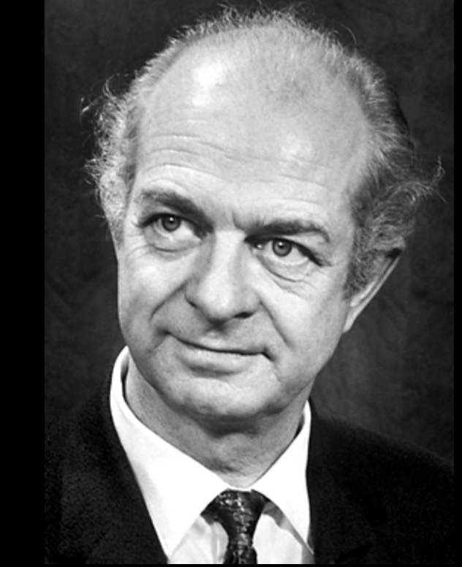
Larry DeLucas, Herb Hauptman & Linus Pauling
The 50th Annual PDC was held in conjunction with the 43rd Annual ACA meeting in Pittsburgh
Larry Delucas had just returned from microgravity crystallization experiments on STS 50 (Columbia) and was going to to talk about the experience
The room was jam packed with people and many waiting outside to get in
Herb Hauptman had sent a poster abstract for the 42nd PDC
However he received a Nobel Prize a couple of weeks before the meeting for his and Jerome Karl’s work on Direct Methods
When asked if he would prefer an oral presentation given his status he said he preferred a poster presentation since he had many talks to do
We rearranged the posters giving him more room since we though that everyone would want to see him and his work
We invited Linus Pauling to give a talk at the PDC and he accepted
He also wanted to talk about vitamin C so we said he could present the talk during the Conference Banquet at the University Club
We then contacted the Pitt News about Pauling visit and found out that Pitts Religious Studies Department had already sent in something about Pauling’s visit and the paper could only do one story

Slide 22
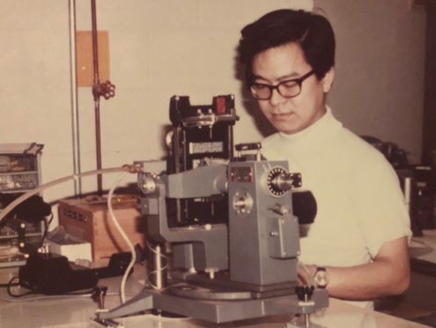
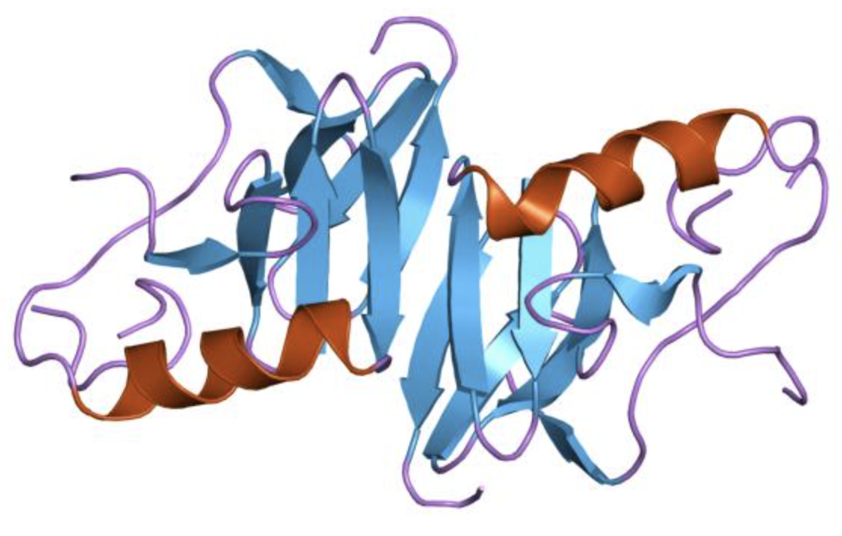
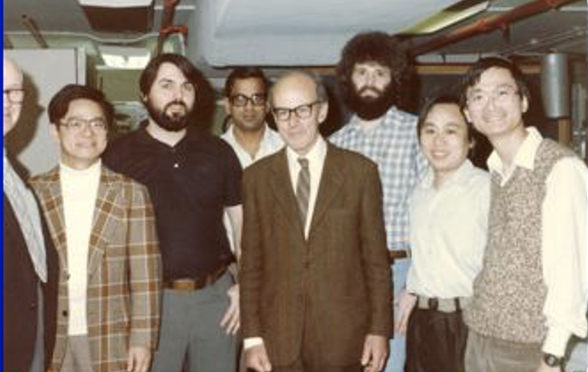
The 1978 PDC Changed My Life
Meeting B.C. Wang changed my life
He hired me to come to Pittsburgh and work as a postdoc on his neurophysin project
I arrived in Pittsburgh in the fall of 1980 and began preparing neurophysin for crystallization, modifying their data processing programs to make them space group general and increase efficiency
Although working at the VA, B.C.’s NIH grant was funded through the Department of Crystallography
I also began spending time in the Department of Crystallography meeting the professors, postdocs and graduate students, and becoming familiar with how things worked
It was during this time I became involved in the Pittsburgh Diffraction Society and the Pittsburgh Diffraction Conference
B.C. and I have been working together since the fall of 1980.
B.C. Wang circa 1977
Bovine neurophysin II
VA group 1985

